Slide 1

QUÉBEC HEALTH
PORTAL PRESENTATION

Slide 2
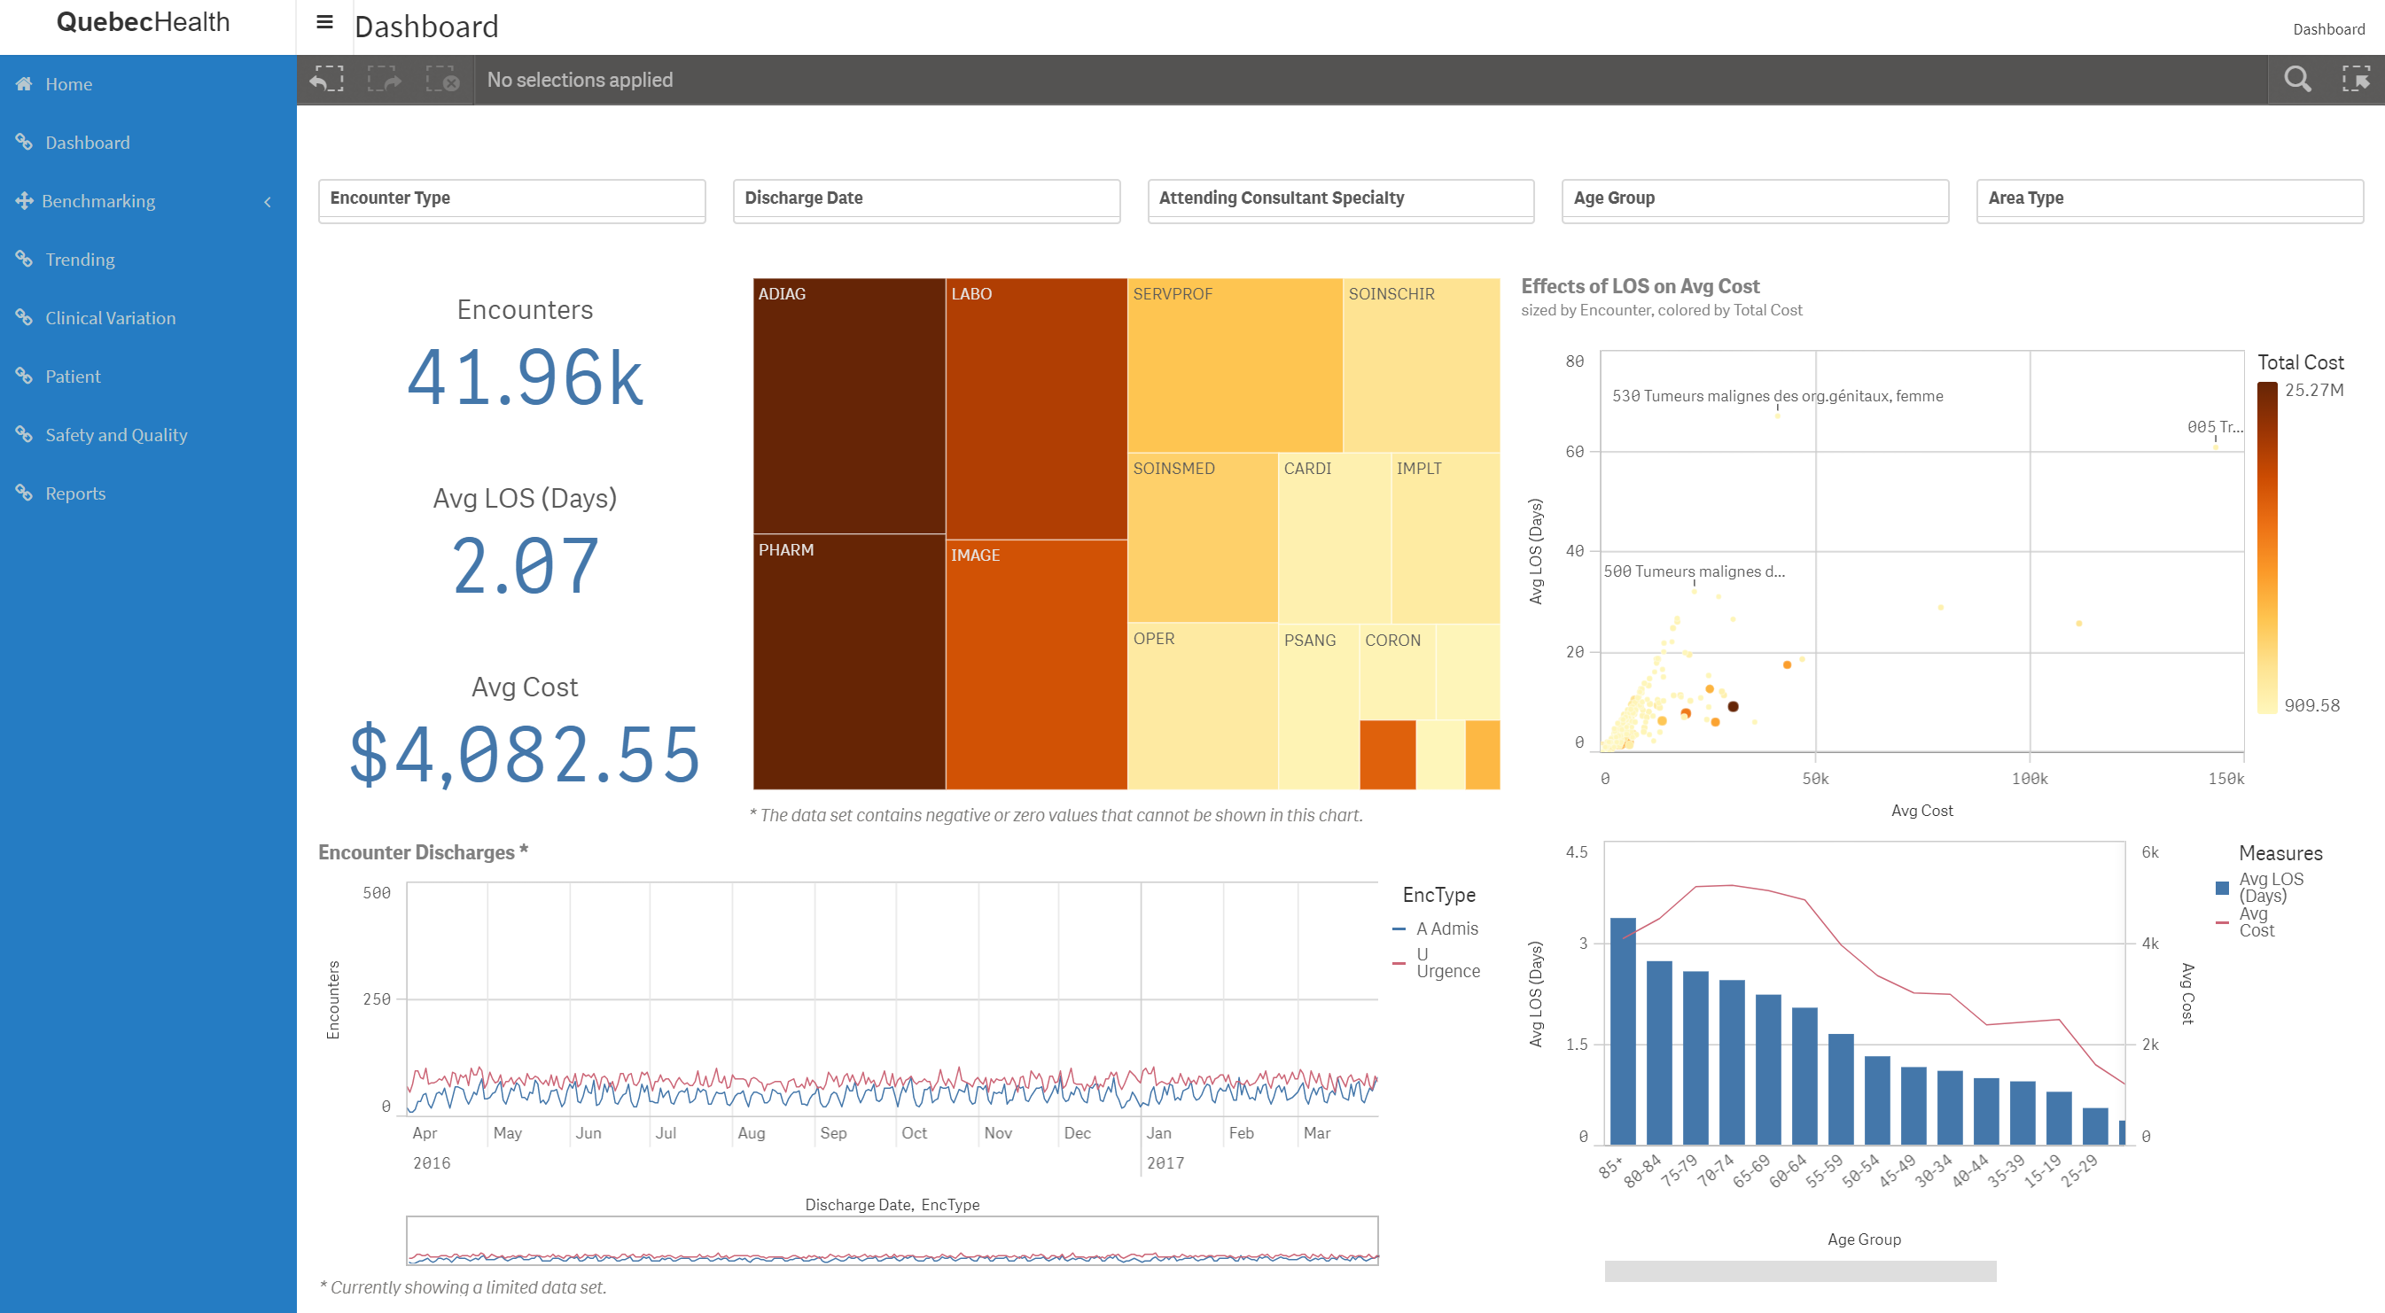
Portal – Dashboard

Slide 3
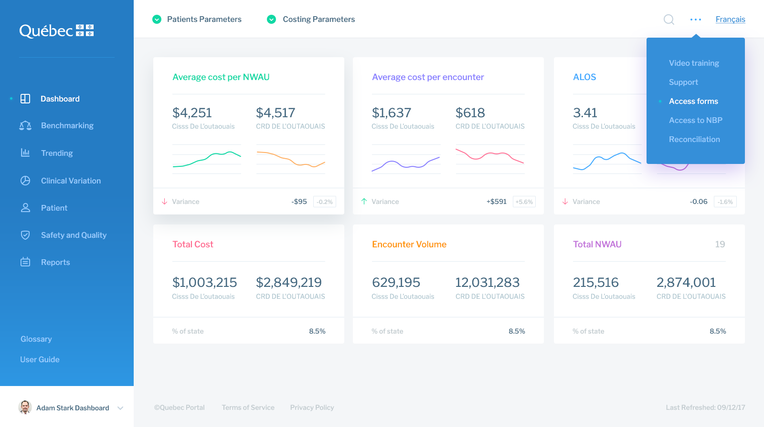
Portal – Dashboard – Menu

Slide 4
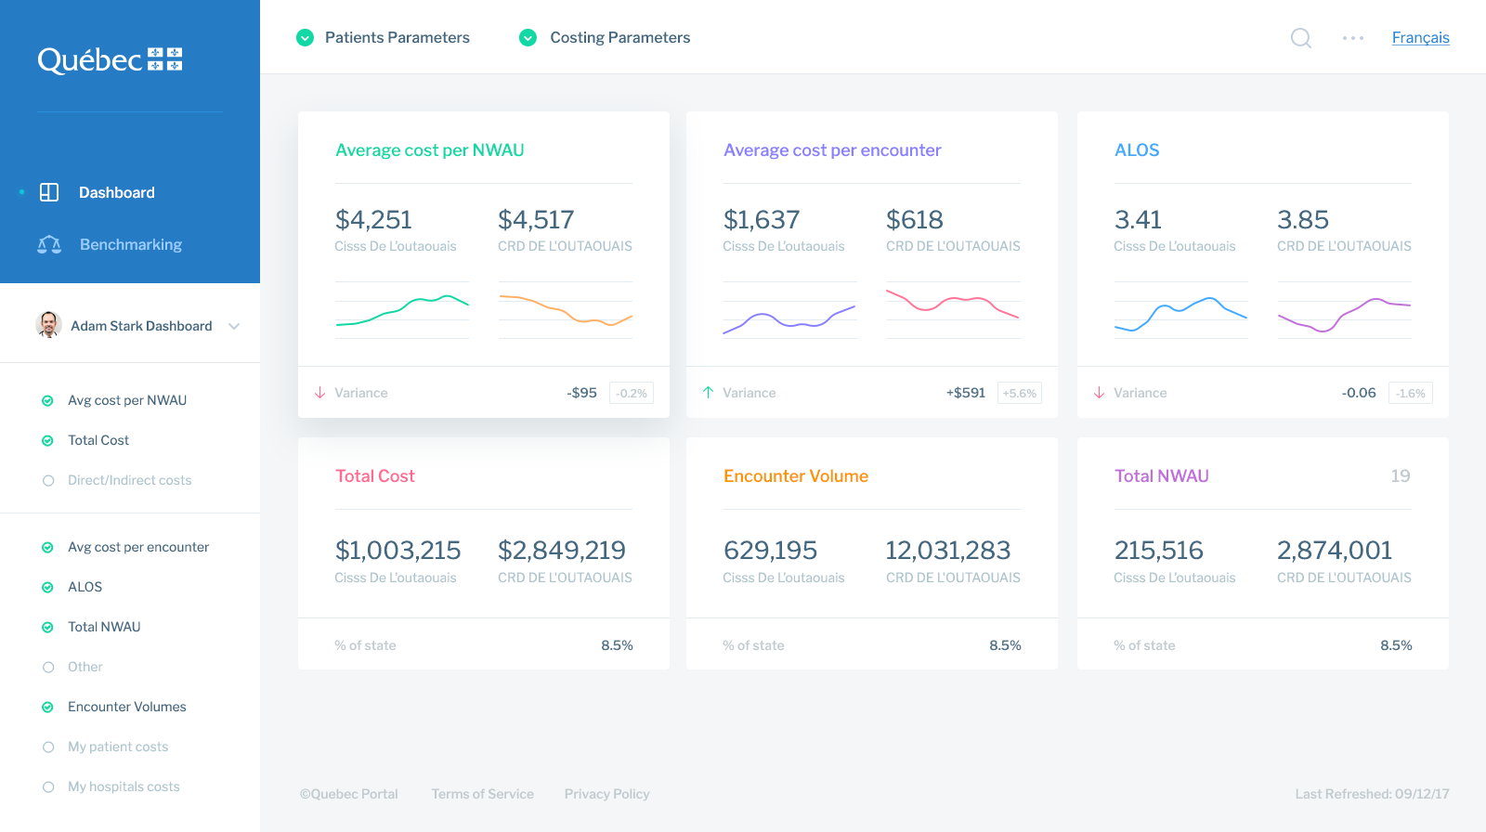
Portal – Dashboard – Filter

Slide 5
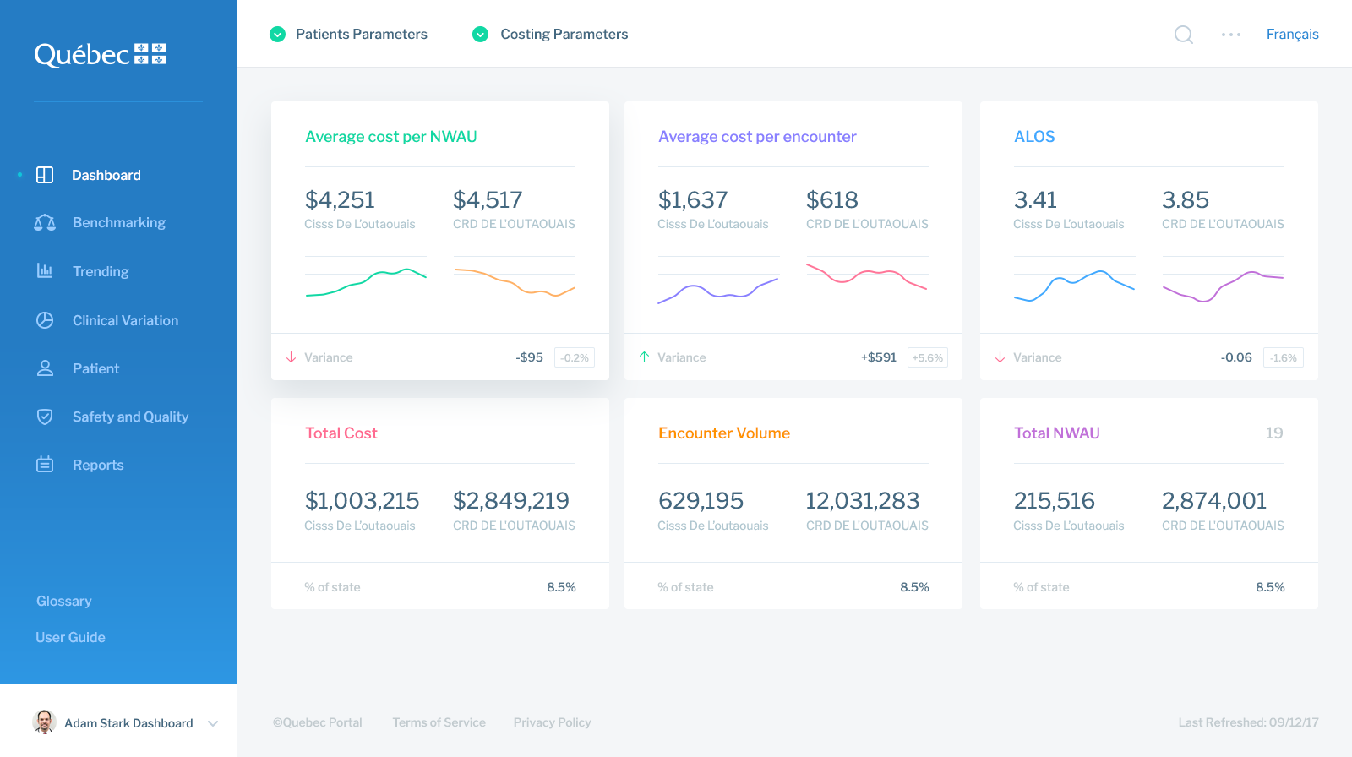
Portal – Dashboard

Slide 6
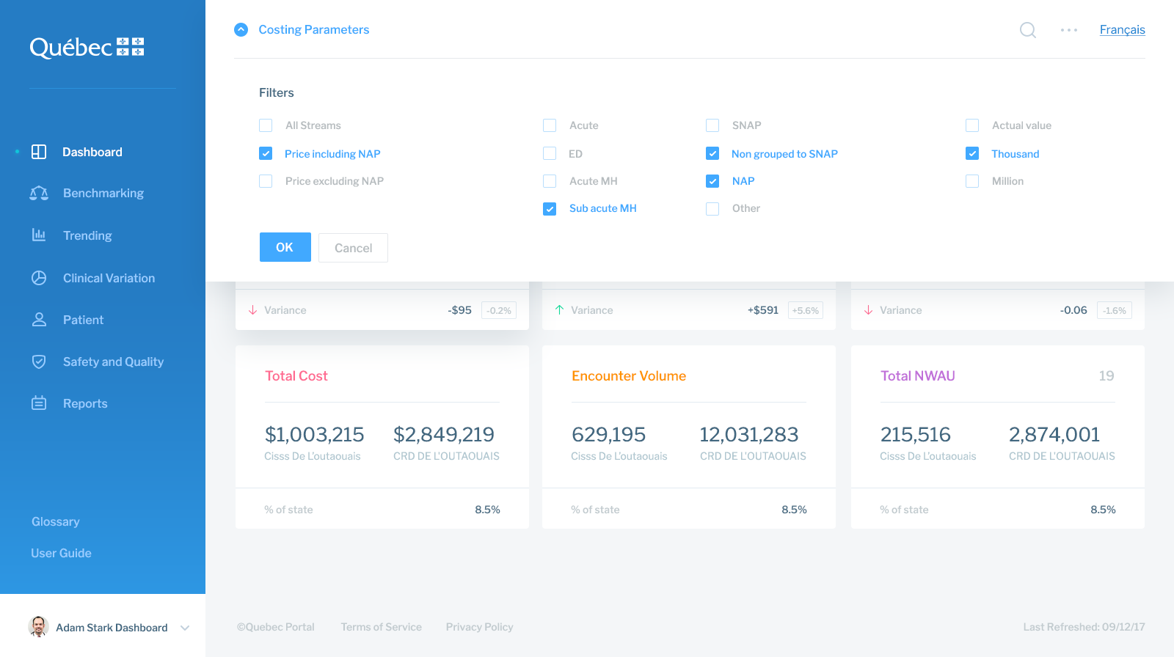
Portal – Dashboard – Costing Parameters

Slide 7
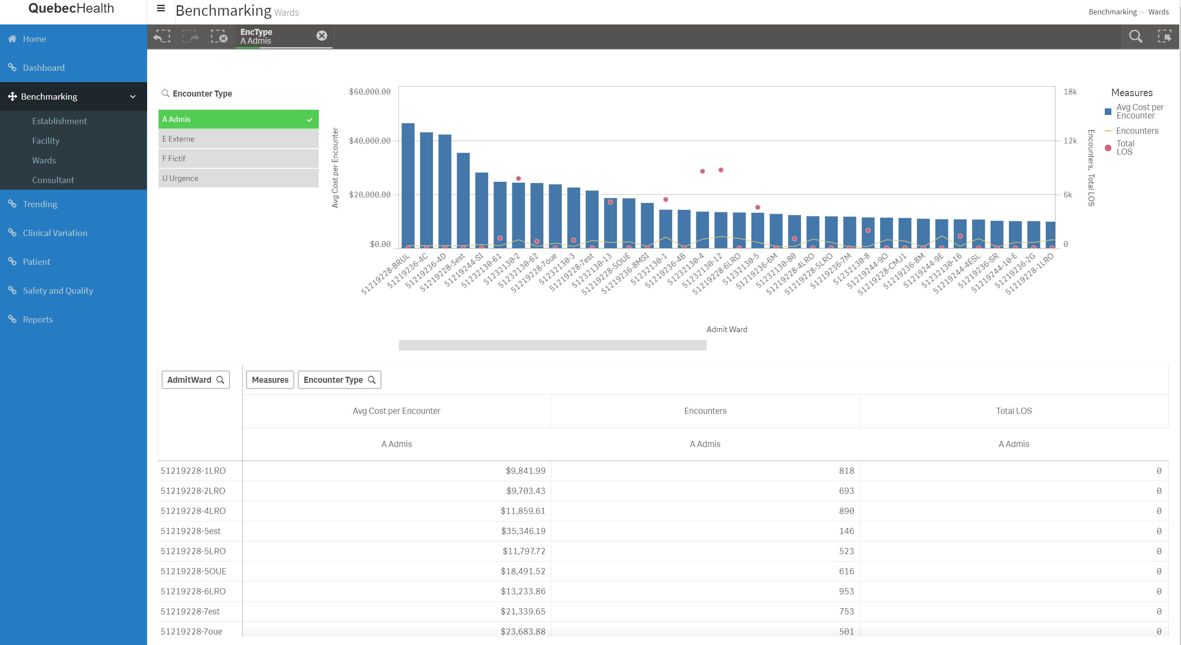
Portal – Dashboard – Patient Parameters

Slide 8
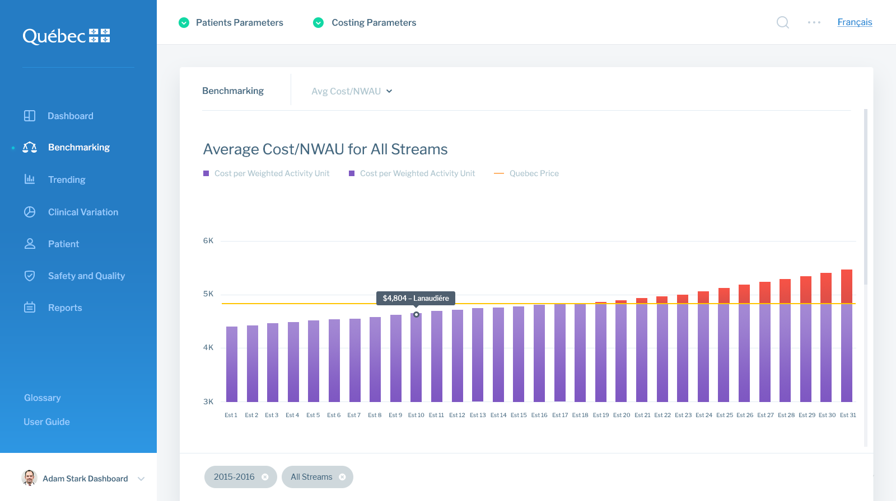
Portal – Benchmark

Slide 9
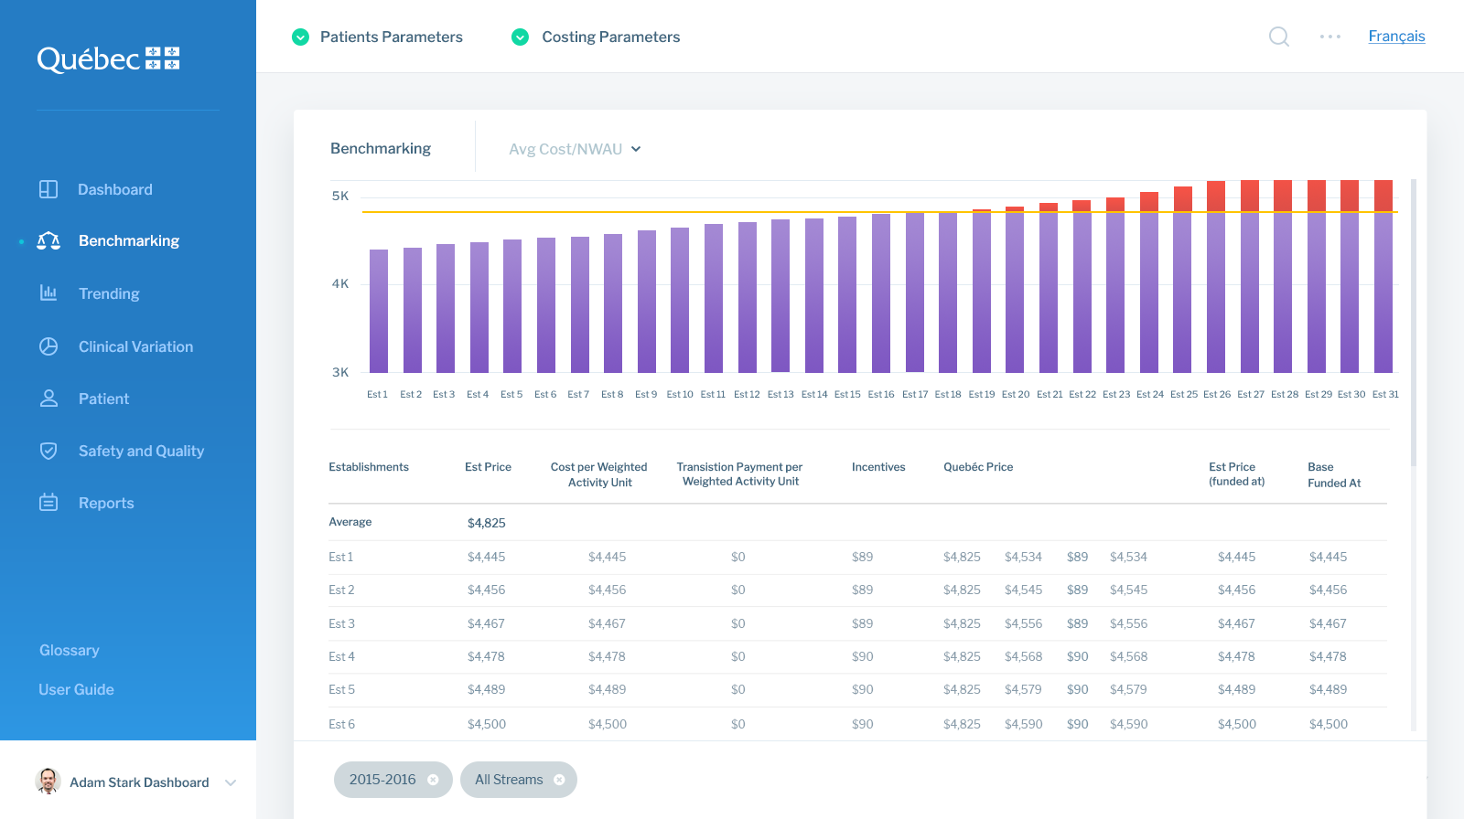
Portal – Benchmark – Table

Slide 10
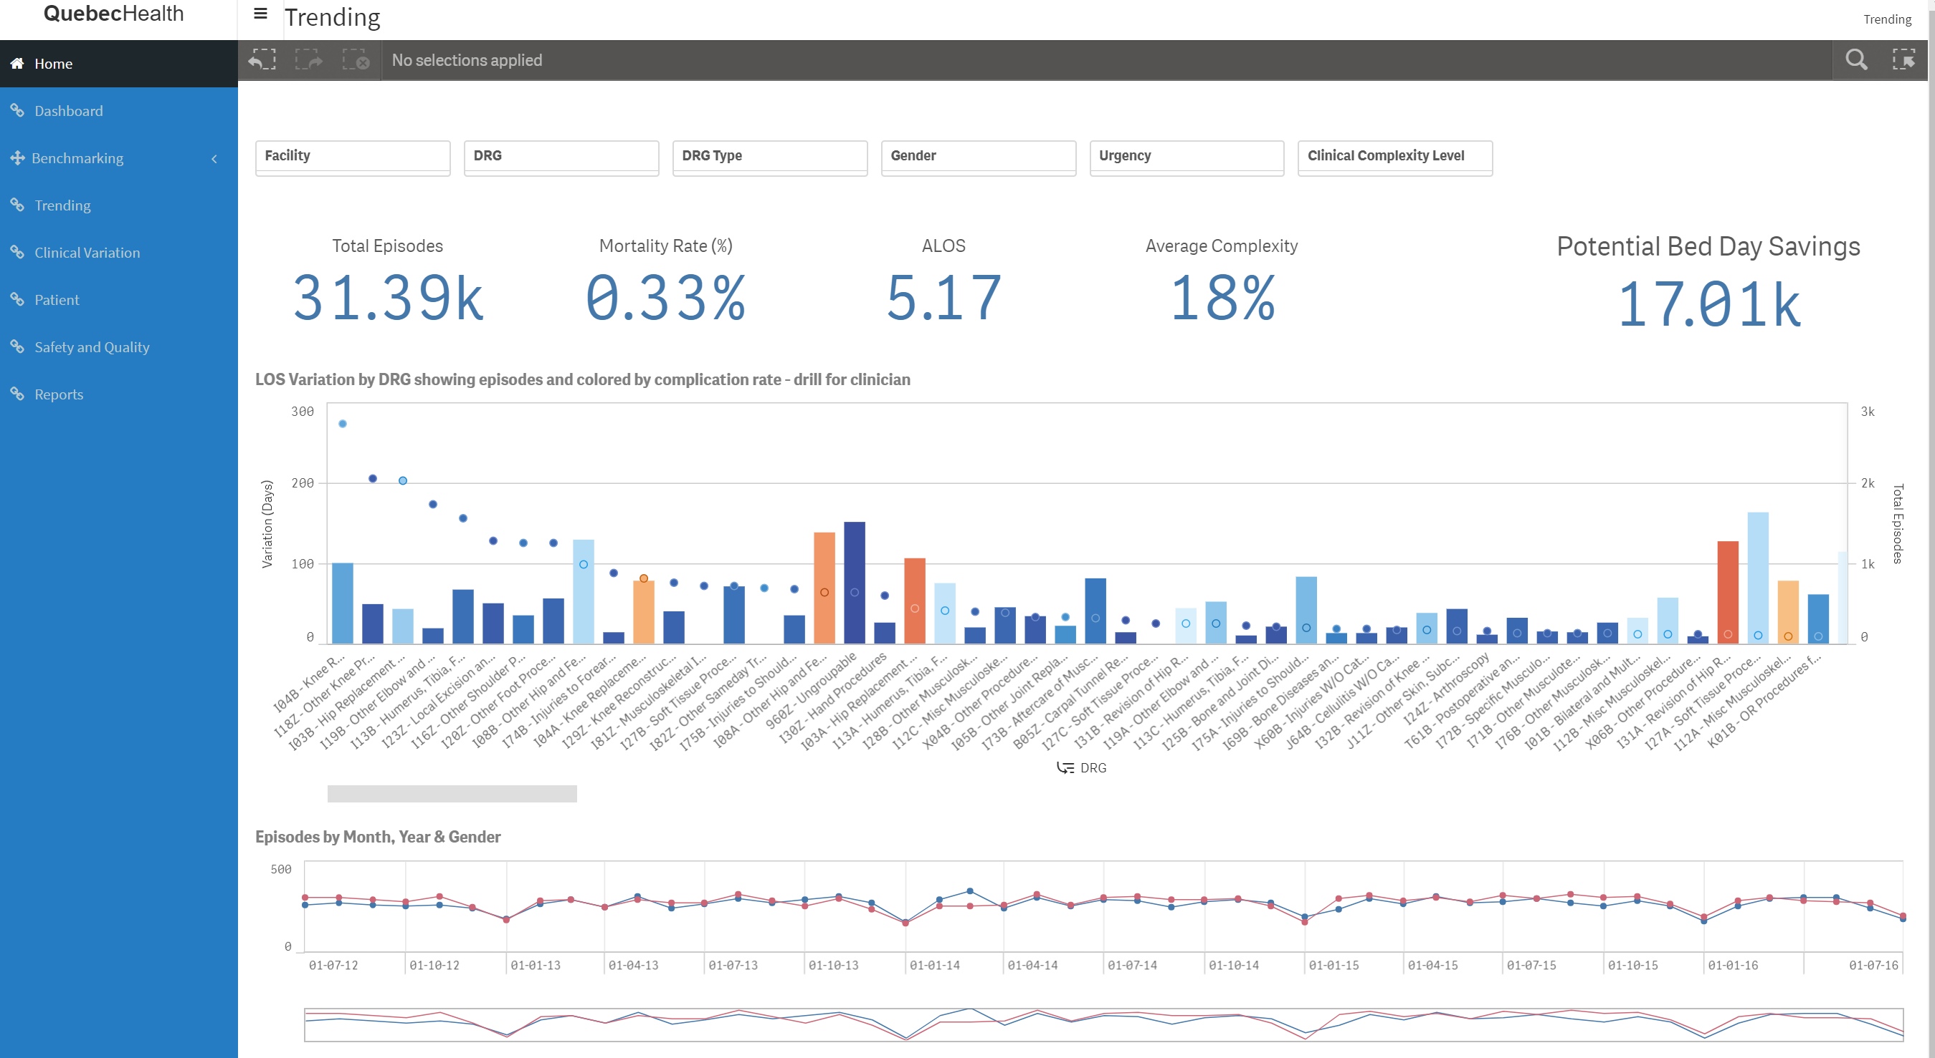
Portal – Dashboard – Costing Parameters

Slide 11
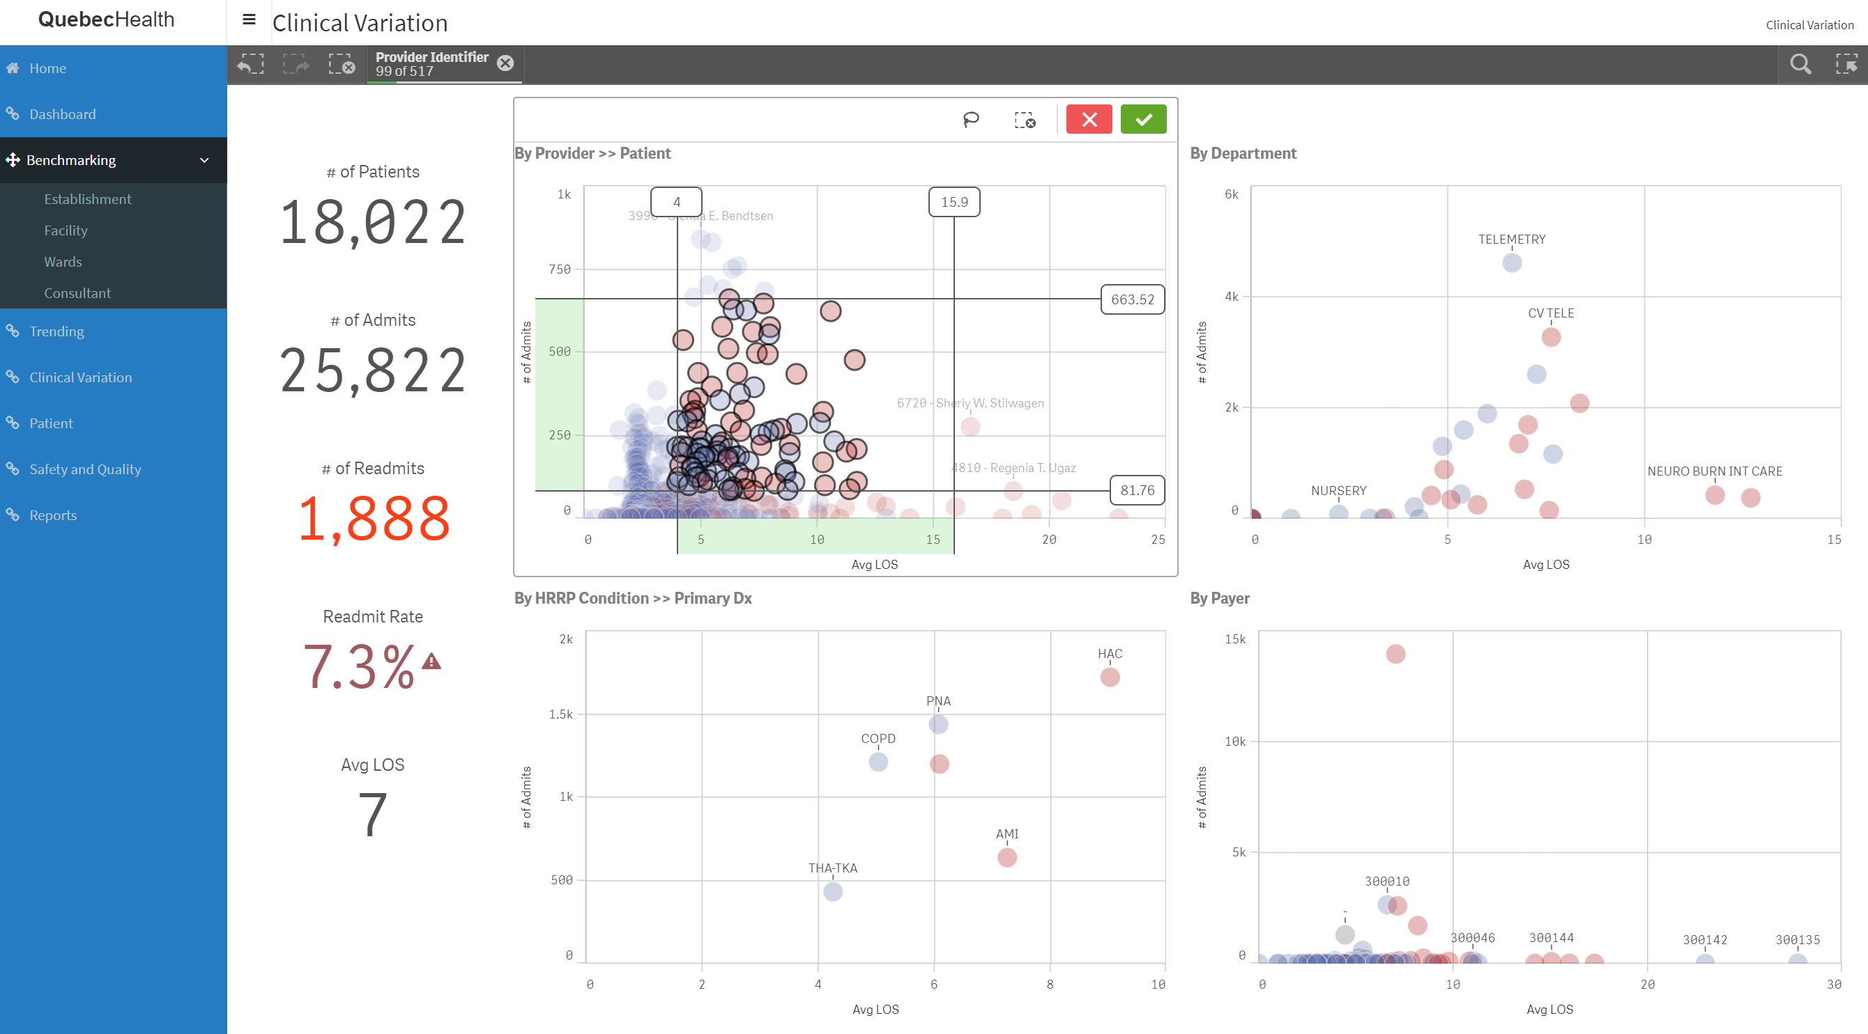
Portal –– Map

Slide 12
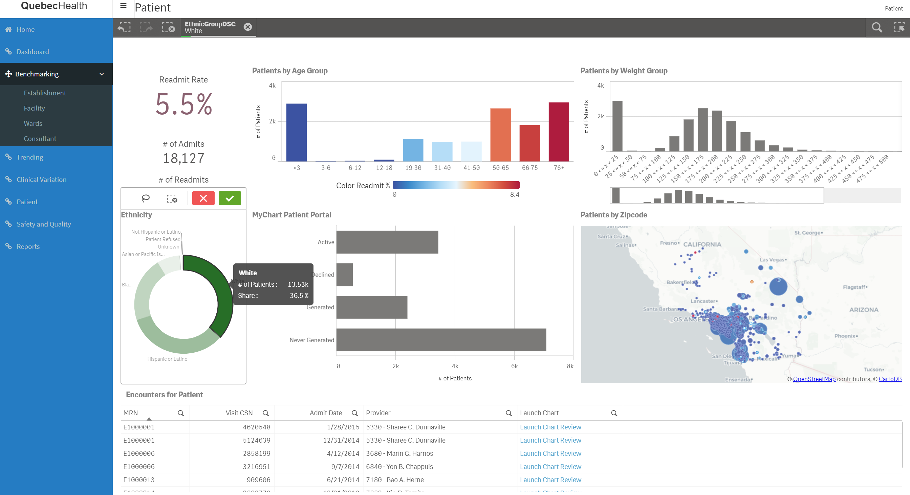
Portal – Dashboard – Search

Slide 13
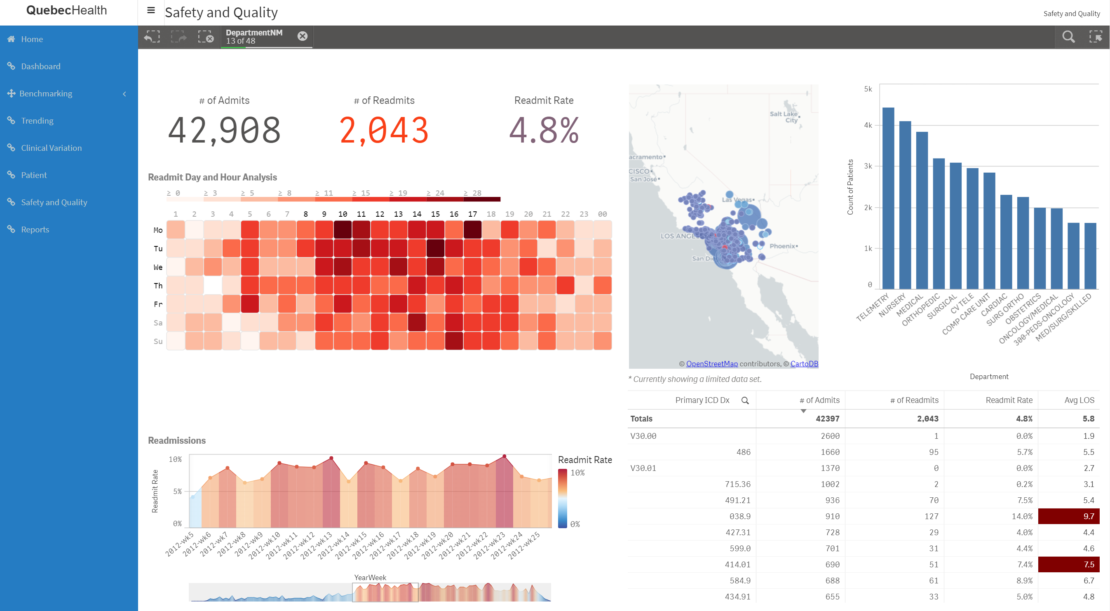
Portal –– Map

Slide 14
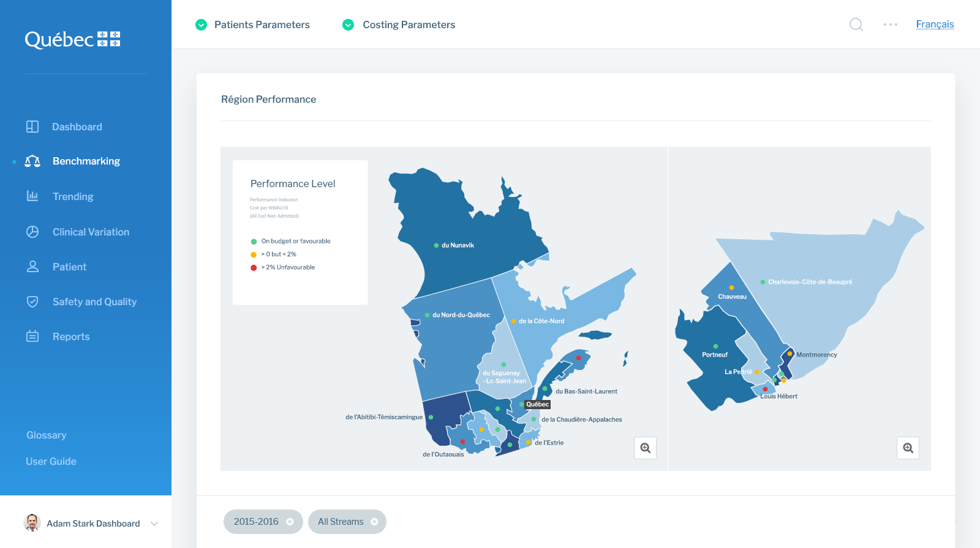
Portal –– Map

Slide 15
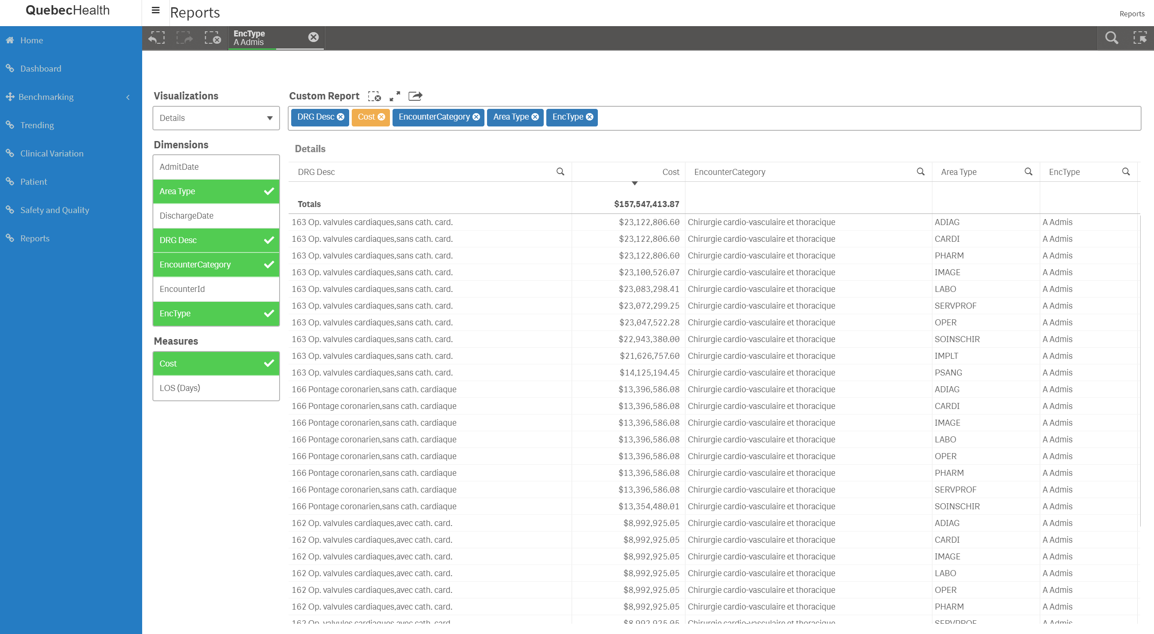
Portal –– Map

Slide 16
Portal Development – next step - DRAFT
Progress the concept development
Incorporate CPSS data from Pilot sites
Develop a Proof of Concept for testing
Identify infrastructure requirements
Workshop Proof of Concept with Normand’s team
Make adjustment to Proof of Concept
Review draft with Normand’s team
Set schedule to test with key stakeholders – clinicians and non clinicians

Slide 17
Final Considerations
Development
Don’t get Perfect in the way of better
Work with Proof of Concepts – scalable
Many variables may explain historical data with high accuracy, but managing so many variables will exhaust most organisations’ capabilities
Define a pragmatic approach to data and data analytics – how to use the data to make better decisions.
Data can be transformed into value!

Slide 18
Final Considerations
Development
Don’t get Perfect in the way of better
Work with Proof of Concepts – scalable
Many variables may explain historical data with high accuracy, but managing so many variables will exhaust most organisations’ capabilities
Define a pragmatic approach to data and data analytics – how to use the data to make better decisions.
Data can be transformed into value!

